Slide 1
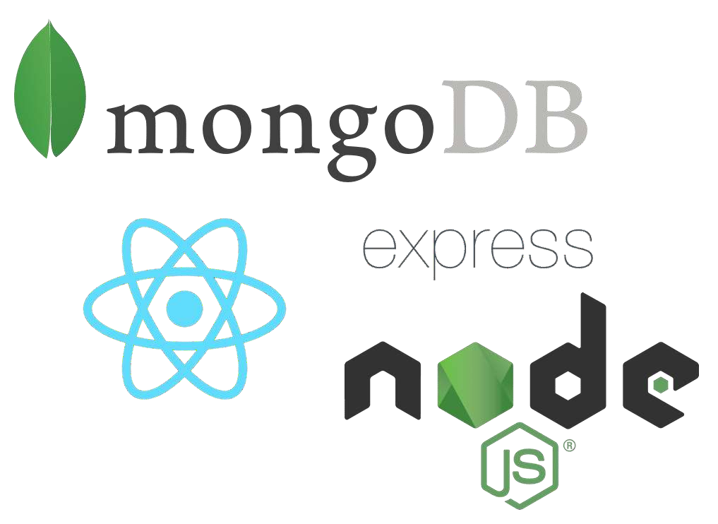
M E R N

Slide 2




What is MERN
MERN is collective name of software stack written in JavaScript for development and deployment of Full Stack Web Application & Software.
MERN comprises of 4 technology stack depending on the use they are classified as follow:
M -
E - ExpressJS
R - React
N -

Slide 3
Prerequisites for MERN stack
• HTML (basics)
• CSS (basics)
• JavaScript (basics)
• Knowledge of database.

Slide 4
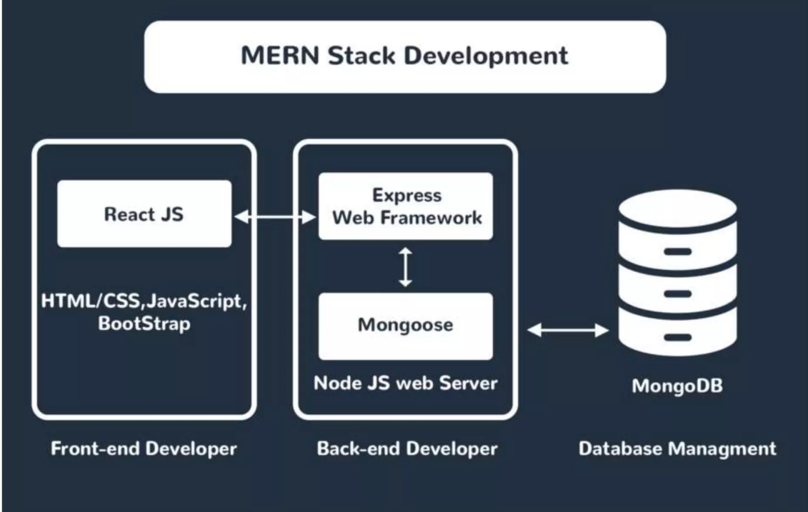

Slide 5

Let’s Break it Down..!
We’ll understand each software stack one by one. Starting with MongoDB:
Easy to Learn.
It is one of the most famous NOSQL(Not Only SQL) Database.
It provide schema(i.e JSON format Data)save time for getting frustrated as newbie working with tables in SQL.
Documents containing key-value pairs are the basic units of data in MongoDB.

Slide 6

ExpressJS
Express is a minimal and flexible Node.js web application framework that provides a robust set of features for web and mobile applications.
It provides easy routing of requests based on HTTP methods and URLs.
Installation of ExpressJS:
https://expressjs.com/ for full reference.

Slide 7
React
A JavaScript library for building user interfaces for web and mobile applications.
React is used to build single-page applications.
React allows us to create reusable Ul components.
React-router to handle the front-end routing.
React was created by Jordan Walke, a Software Engineer at Facebook.

Slide 8
How does React work?
• Instead of manipulating the browser's DOM directly, React creates a Virtual DOM in memory, where it does all the necessary manipulating, before making the changes in the browser DOM.
• React finds out what changes have been made, and changes only what needs to be changed.

Slide 9
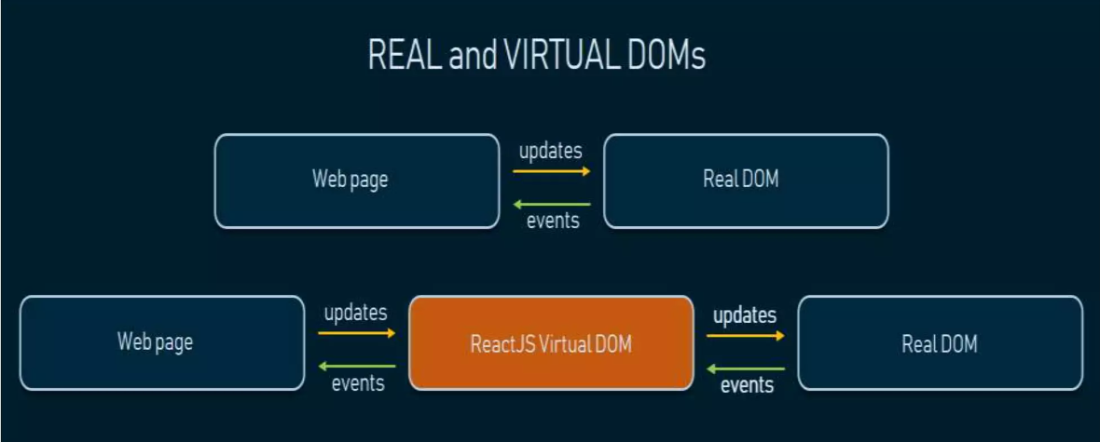
How does React DOM work?

Slide 10
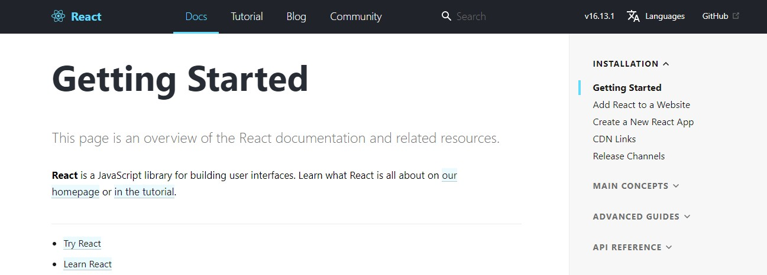
Installation of React
For reference : https://reactjs.org/docs/getting-started.html

Slide 11


NodeJS
NodeJS is basically used to develop and interact with server-side programs.
NodeJS is open-source and supports cross-platform development.
NodeJS uses Event-Driven architecture i.e The network connection between apps should be managed by event loop and worker pool.
For reference take 5 min look at the Doc :https://nodejs.org/en/docs/

Slide 12
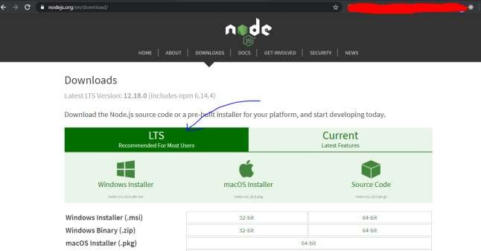

NodeJS
After installation just check the version by:
node –v in cmd to ensure the version and complete installation
Download Reference : https://nodejs.org/en/download/

Slide 13


Web Development changes drastically over period of time.
The website needed in 2010 is different from website needed in 2020. Nowadays, Website are getting dynamics that are meant to serve all functionality i.e fetching data, retrieving data ,updating, discussion , etc in the meantime.
Learning a single language(JAVASCRIPT) and further opting MERN serve all the things and the stacks are In Demand in today’s job market.
So, Why to wait ..Learn today.!

